Slide 1


Slide 2
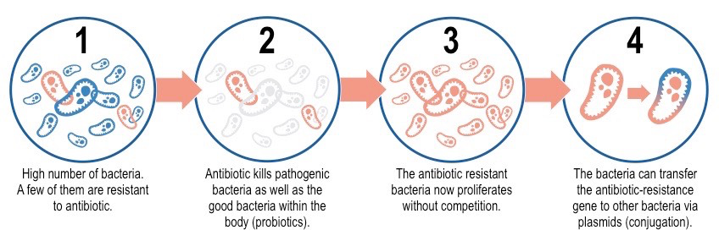
MECHANISMS OF ANTIBIOTIC RESISTANCE

Slide 3
Definition
Antibiotic Resistance: Relative or complete lack of effect of antibiotic against a previously susceptible micro-organism

Slide 4
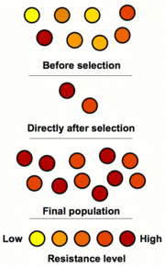

Slide 5
Factors promoting resistance
Inappropriate drug use-
Lack of quality control i.e. Outdated
Misused by individuals: taken for viral infections.
Use of antibiotics in foods (used agriculture and farming)

Slide 6
Questions in book
Done? Create a comic strip showing antibiotics, bacteria and and antibiotic resistance.
Without bacteria what bodily process would stop?
How many people before 1930 died of infection?
How are bacteria becoming antibiotic resistant?
How many antibiotic prescriptions are dispensed annually in Australia?
How many people does resistance kill each year worldwide?
This is expected to rise to 10 million by….
In Australia what % of antibiotics is used on animals?
Australian pig farmers are looking at alternatives to antibiotics. Name one of them.
What are 3 methods of reducing antibiotic resistance?

Slide 7

END-Catalyst

